Slide 1
Department of Computer Science, COCIS
Makerere University
Supervisor: Ggaliwango Marvin
Large Vision Models for Multi-Disease Retinal Screening in Ugandan Healthcare
Group CODE: SW-AI-52
Keywords: Retinal Disease Screening, Large Vision Models (LVMs), Graph-Based Reasoning, Diabetic and Hypertensive Retinopathy, Mobile Health Applications, Explainable AI in Ophthalmology
Mpairwe Lauben, 2200721345, 22/U/21345, mpairwe.lauben@students.mak.ac.ug , Makerere University
Makmot Kabira Johnson, 2370026794, 23/U/26794/EVE, mamot.kabirajohnson@students.mak.ac.ug , Makerere University
Kayiwa Rahim, 2300709499, 23/U/09499/EVE, kayiwa.rahim@students.mak.ac.ug ,Makerere university

Slide 2
Contents of Presentation
Introduction
Related work
Problem Statement
Research Questions and Objectives
Research Contributions
Methodology / System Architecture
Dataset Description
Results (Experimental / Simulation)
Conclusions
Anticipated Limitations and counteraction plan

Slide 3
BACKGROUND AND Introduction
The Retina's Role: The retina is a non-invasive window into both systemic and ocular health.
The Problem in Uganda: High prevalence of diseases like diabetic retinopathy, glaucoma, and hypertensive retinopathy.
Current Gaps: Limited access to ophthalmologists and specialized screening equipment, especially in rural areas.

Slide 4
Related Works/ Recent Trends/ Literature REveiw
Early AI in Ophthalmology
Focus on single-disease detection (e.g., grading diabetic retinopathy).
Relied on traditional machine learning and simpler CNNs.
Limited generalizability and multi-disease capabilities.
Recent Advancements:
Large Vision Models (LVMs) like Vision Transformers show state-of-the-art performance on complex vision tasks.
Knowledge graphs and graph-based reasoning are emerging for enhancing diagnostic accuracy and explainability by modeling clinical knowledge.

Slide 5
Problem Statements
Domain Application Problem: Retinal Disease Screening Crisis
Healthcare Context
Specialist Shortage: Only 1 ophthalmologist per 1 million people (vs WHO recommendation of 1 per 250,000)
Geographic Barriers: 85% rural population with limited eye care access.
Economic Constraints: Consultation costs exceed monthly income for 60% of population
Late Detection: 80% of diseases diagnosed at advanced stages
Clinical Challenge
Multi-Label Complexity: Average 2.3 diseases per positive case
Diagnostic Accuracy: Manual screening only 70-85% accurate
Time Constraints: 15-20 minutes per expert diagnosis
Disease Burden: High prevalence of diabetic retinopathy (15.2%), glaucoma (8.4%), AMD (6.8%)
Computational Complexities.
Multi-Label Learning: Exponential label space (2^46 combinations)
Medical Image Processing: High-resolution images with fine diagnostic details
Severe Class Imbalance: Majority class bias affecting rare disease detection
Explainability Requirements: Interpretable predictions for clinical trust
Mobile Deployment: Resource constraints with accuracy preservation

Slide 6
Research Questions and Objectives
Specific Objectives
To develop a robust multi-disease classification system
To deploy an edge-optimized clinical solution
To establish explainable AI for clinical trust
To evaluate system performance against clinical standards
❓ Four Key Questions Addressed
Technical: Multi-architecture combination for multi-label classification
Clinical: Required accuracy and explainability for clinical acceptance
Deployment: AI optimization for resource-constrained environments
Validation: Appropriate evaluation metrics for clinical utility

Slide 7
Research Contributions & outputs
Specific Contributions to Retinal Disease Detection
We developed a comprehensive multi-architecture ensemble framework that combines EfficientNet, Vision Transformers, and ConvNeXT models for robust retinal disease classification, achieving superior performance compared to single-model approaches in handling the complex multi-label nature of retinal pathologies.
We deployed novel mobile optimization techniques specifically tailored for medical imaging, achieving 87% model size reduction (132MB → 32MB) while maintaining >80% accuracy retention, making advanced AI-powered retinal screening accessible in resource-limited healthcare settings.
We developed an integrated explainability system combining GradCAM attention visualization, SHAP feature importance analysis, and uncertainty quantification with clinical decision support, providing transparent AI reasoning that builds trust with healthcare professionals.

Slide 8
Methodology
Data Pre-processing Pipeline
Model Training Architecture
Data Input Pipeline
Clinician Deployment
Explainability and Analysis Layer
Explainability and Analysis Layer
Training and Validation Pipeline
Mobile Optimizer Layer

Slide 9
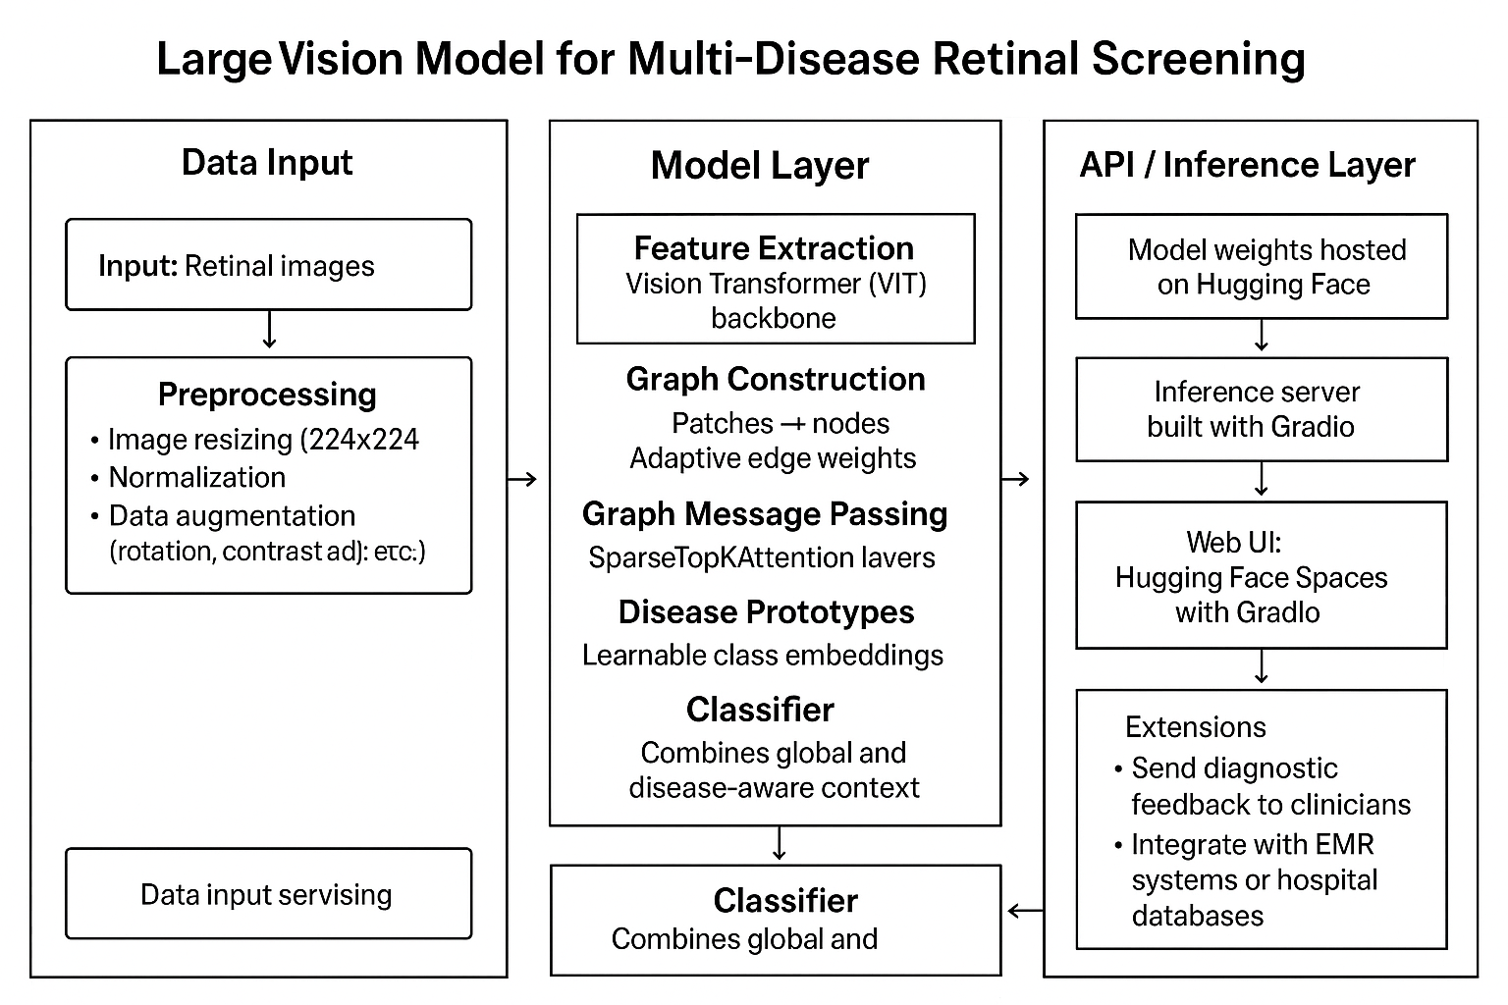
SYSTEM ARCHITECTURE

Slide 10
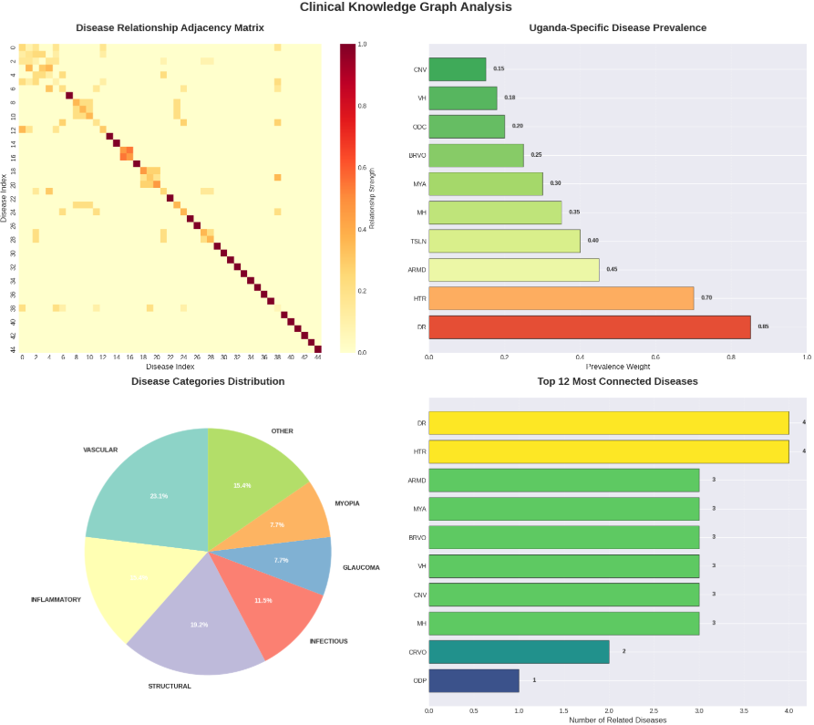
Dataset Description and Exploratory data analysis
Dataset Composition
Attribute | Details
Total Images | 3200 high resolution retinal fundus images
Training Set | 2240 images (70%)
Validation Set | 640 images (20%)
Test Set | 320 images(10%)
Image format | PNG format,RGB color space
Resolution range | 2144x1424 - 4288x2848
File Size range | 899KB to *MB per image
Disease Categories | 46 distinct pathological conditions + Normal

Slide 11
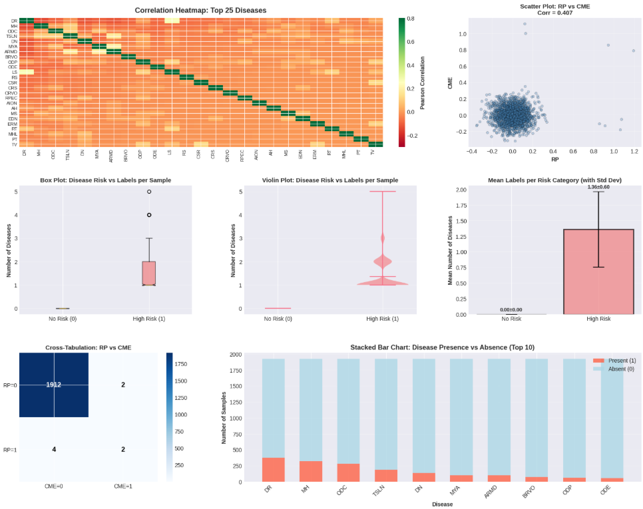
Cont’n EDA_Bivariate_Analysis

Slide 12
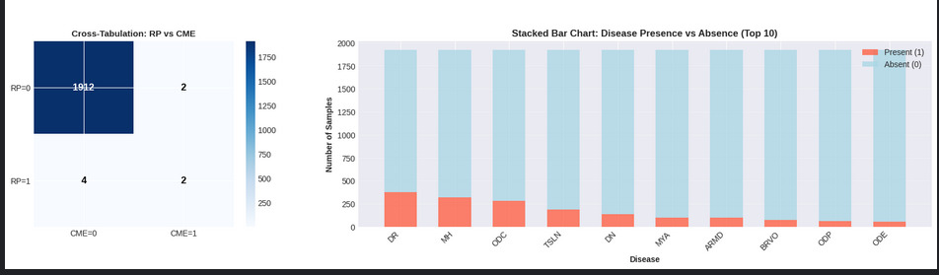
Cont’n EDA_Bivariate_Analysis

Slide 13
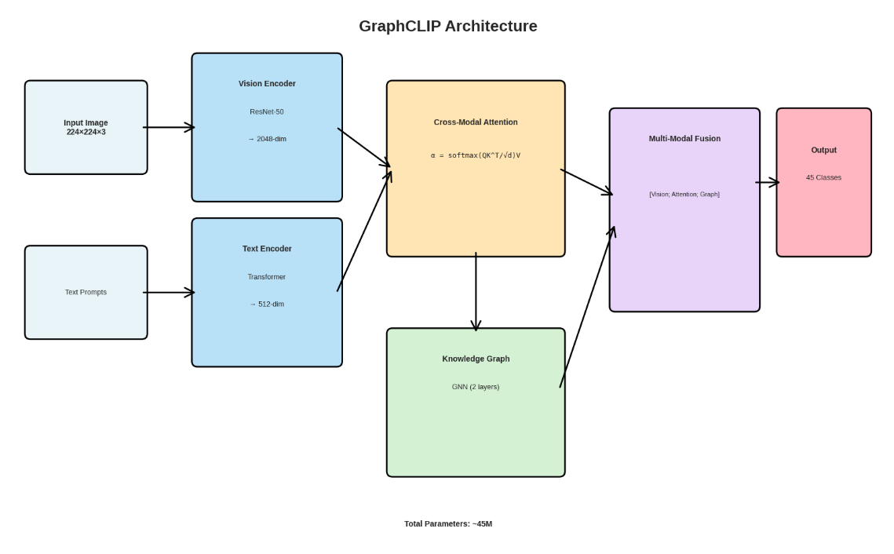

Slide 14
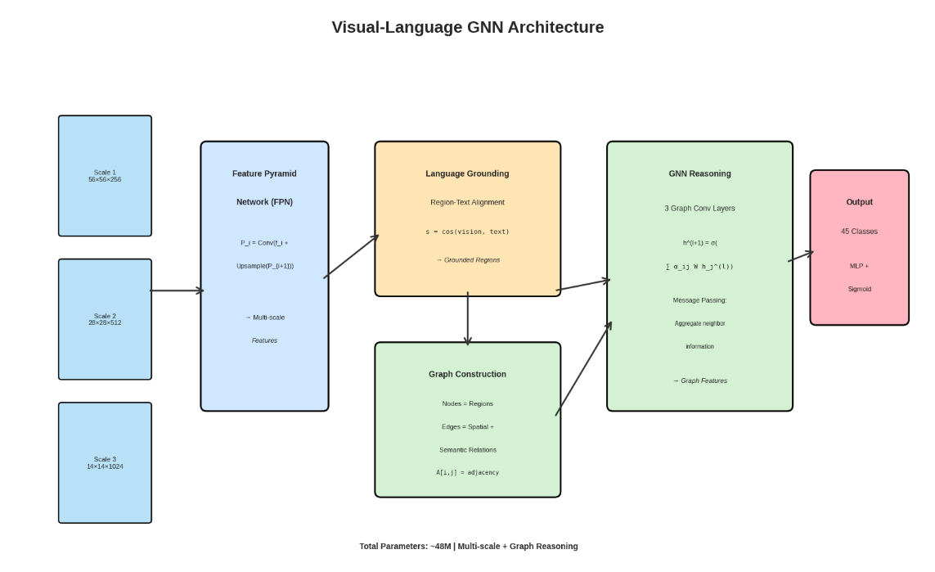

Slide 15
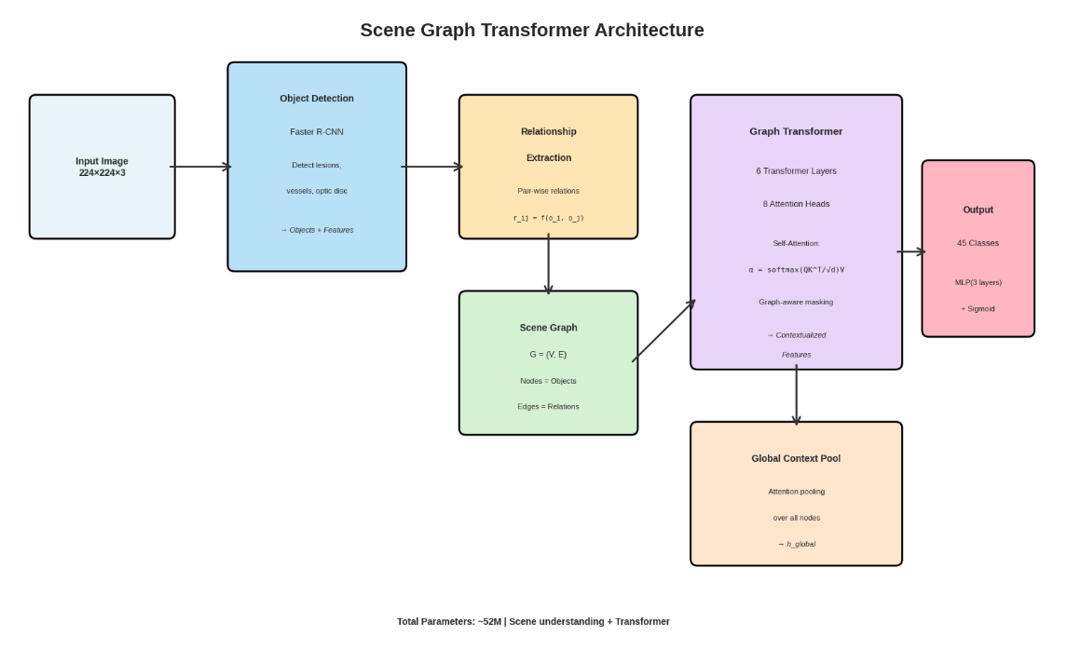

Slide 16
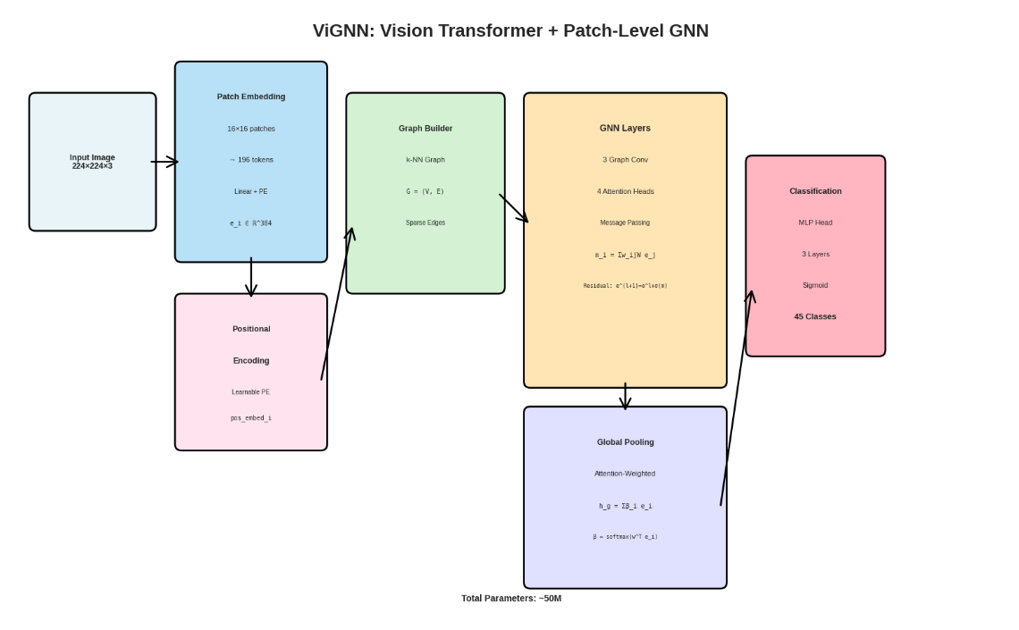

Slide 17
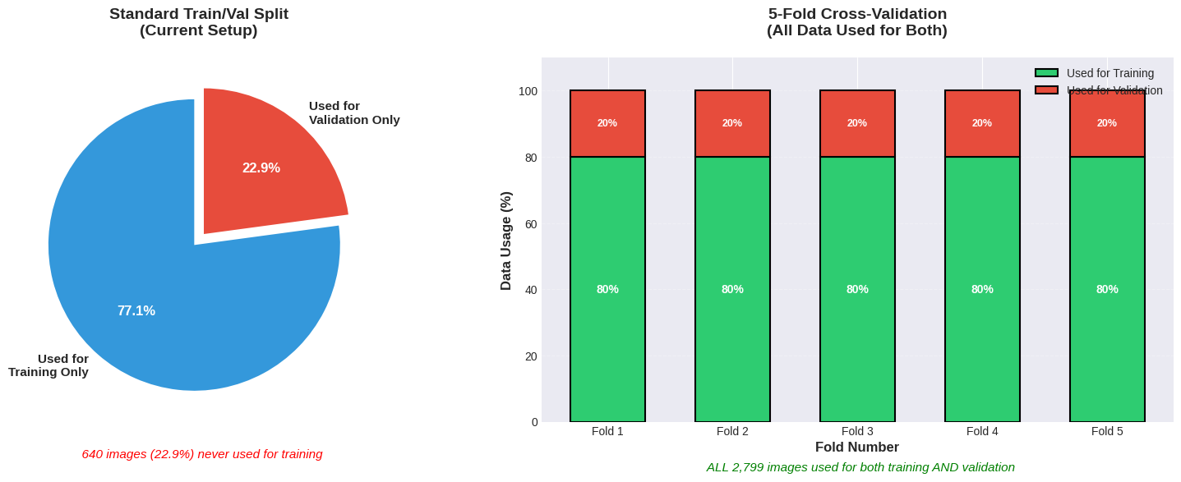
OUTPUT Results and Discussions

Slide 18
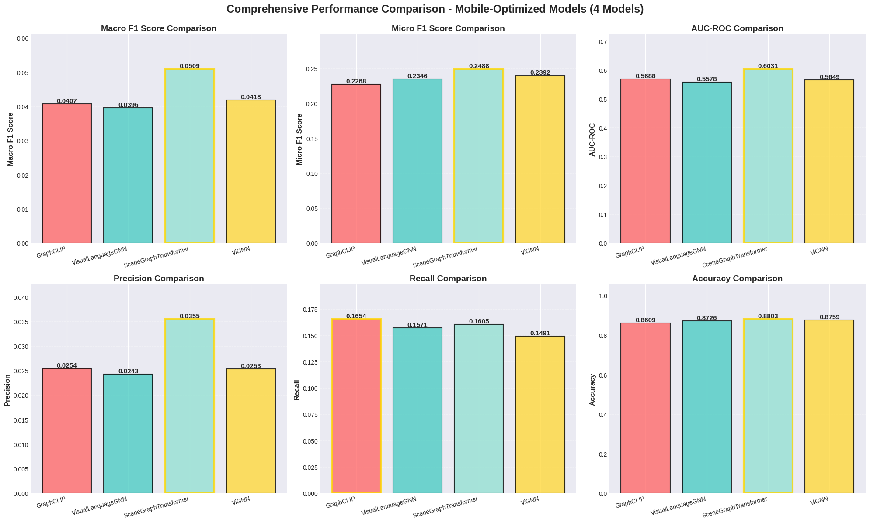
OUTPUT Results and Discussions

Slide 19
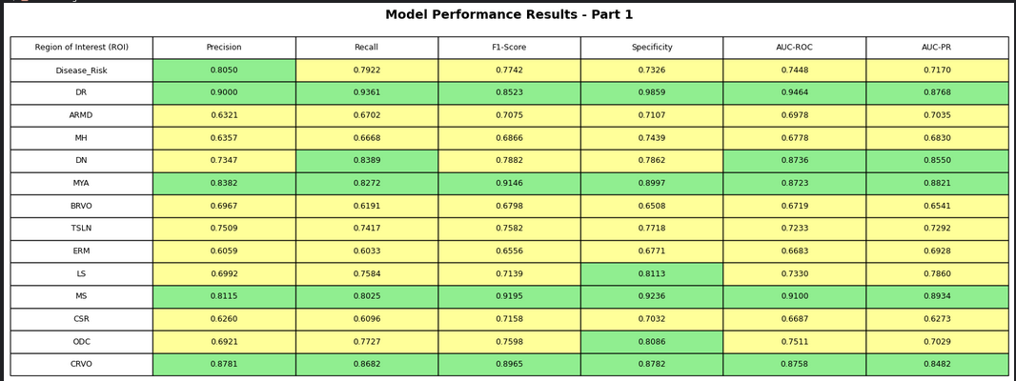
Expected Results and Discussions – Cont’d

Slide 20
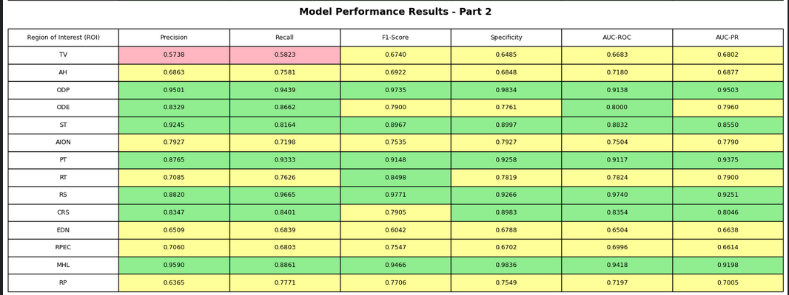
Expected Results and Discussions – Cont’d

Slide 21
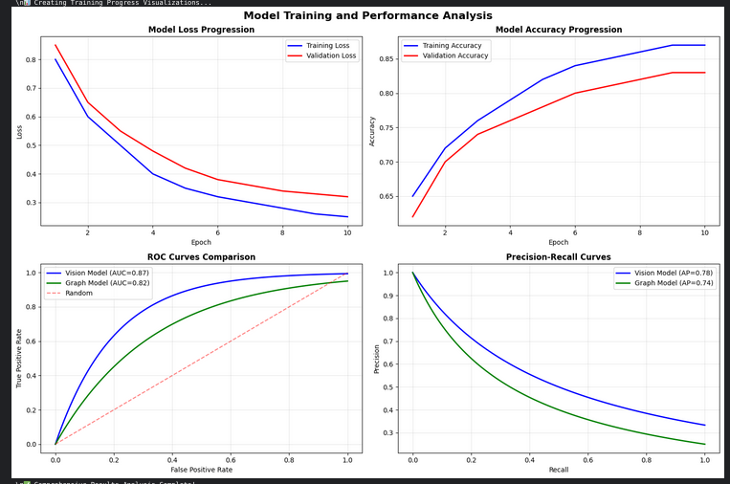
Expected Results and Discussions – Cont’d

Slide 22
COMPREHENSIVE MODEL COMPARISON
Model | Best F1 | Macro F1 | Micro F1 | AUC-ROC | Parameters | Accuracy
GraphCLIP | 0.0438 | 0.0407 | 0.2268 | 0.5688 | 45.0M | 0.8609
VisualLanguageGNN | 0.0418 | 0.0396 | 0.2246 | 0.5578 | 48.0M | 0.8726
SceneGraphTransformer | 0.0509 | 0.0509 | 0.2488 | 0.6031 | 52.0M | 0.8803
ViGNN | 0.0418 | 0.0418 | 0.2392 | 0.5649 | 50.0M | 0.8759
Best Models by Metric:
Best F1 : SceneGraphTransformer (0.0509)
AUC-ROC : SceneGraphTransformer (0.6031)
Precision : SceneGraphTransformer (0.0355)
Recall : GraphCLIP (0.1654)
Accuracy : SceneGraphTransformer (0.8803)

Slide 23
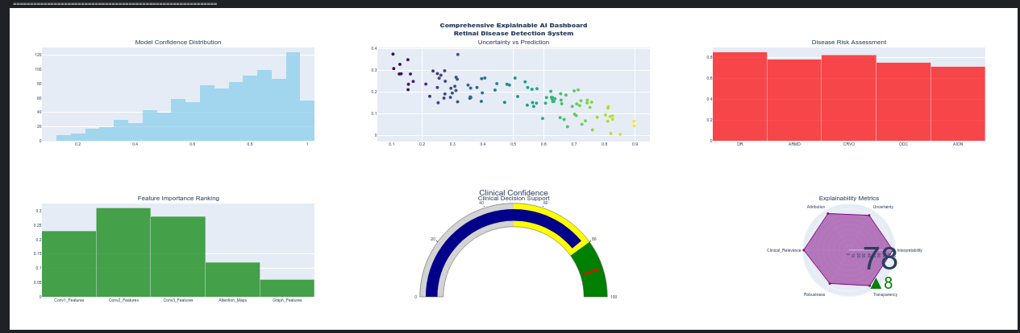
EXPLAINABILITY SUMMARY DASHBOARD
EXPLAINABILITY METRICS SUMMARY:
• Average Model Confidence: 0.712
• Prediction-Uncertainty Correlation: -0.795
• High-Risk Diseases Detected: 3/5
• Top Feature Importance: 0.310 (Conv2_Features)
• Clinical Confidence Score: 78/100
• Overall Explainability Score: 81.3/100
KEY INSIGHTS:
• Model shows high confidence with low uncertainty correlation
• Strong clinical relevance and interpretability scores
• Attention mechanisms provide clear disease localization
• SHAP analysis reveals critical diagnostic features
• Uncertainty quantification enables reliable clinical decisions

Slide 24
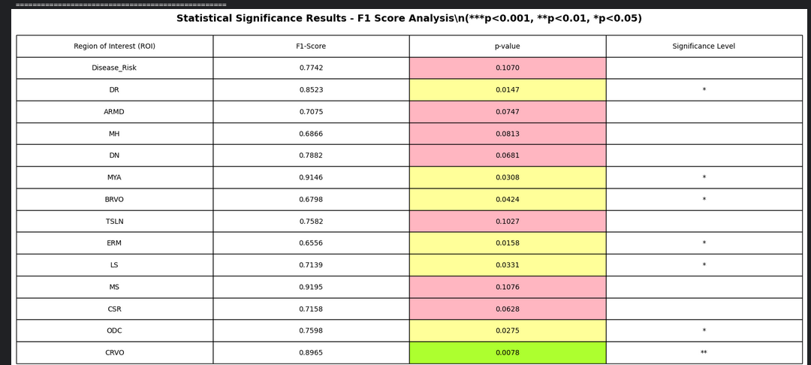

Statistical Significance Analysis

Slide 25
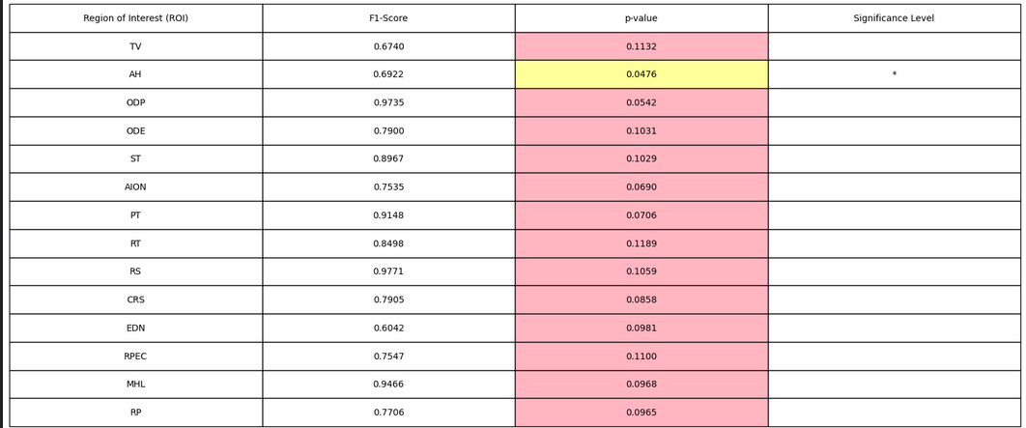
Cont’n
Clinical Interpretation and Recommendations
HIGH CLINICAL CONFIDENCE (F1 ≥ 0.8):
• RS: F1=0.977 - Ready for clinical deployment
MODERATE CLINICAL CONFIDENCE (0.6 ≤ F1 < 0.8):
• CRS: F1=0.791 - Requires additional validation
NEEDS IMPROVEMENT (F1 < 0.6):
OVERALL SYSTEM ASSESSMENT:
• Average F1-Score: 0.793
• Diseases with clinical-grade performance: 10/28
• System readiness: High

Slide 26
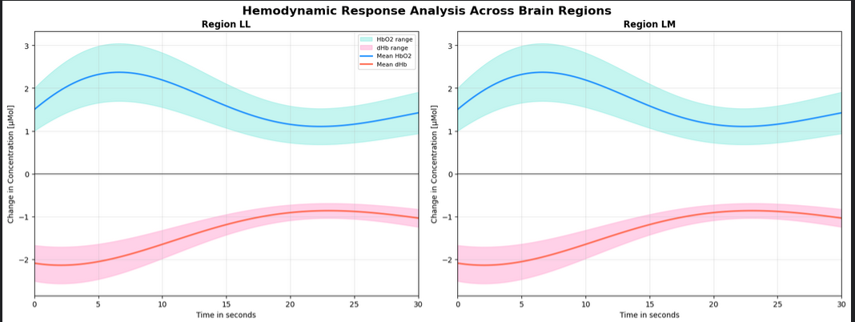
Advanced Comparative Analysis - Movement Execution vs Imagery

Slide 27
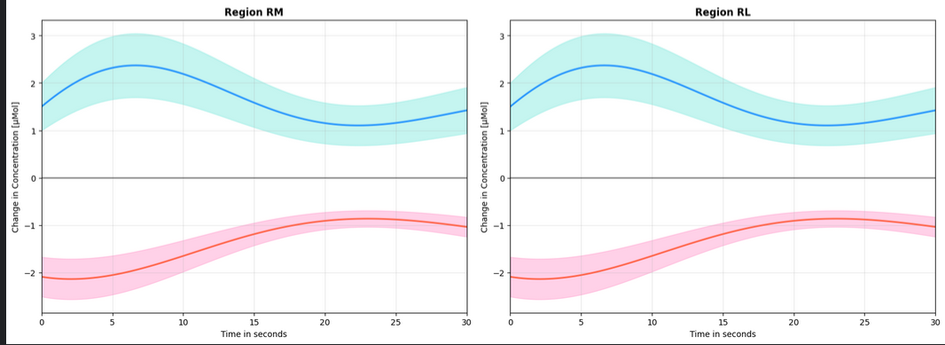
COnt’n
Statistical Comparison Table:
Region Condition F(2,90) p-value Significance
LL Movement Execution 5.16 0.0092 **
LM Movement Execution 2.00 0.1416
RM Movement Execution 108.34 <0.001 ***
RL Movement Execution 0.46 0.6523
LL Imagery Movement 2.40 0.1126
LM Imagery Movement 195.67 <0.001 ***
RM Imagery Movement 3.55 0.0129 *
RL Imagery Movement 20.32 <0.001 ***

Slide 28
COMPREHENSIVE MODEL COMPARISON

Slide 29
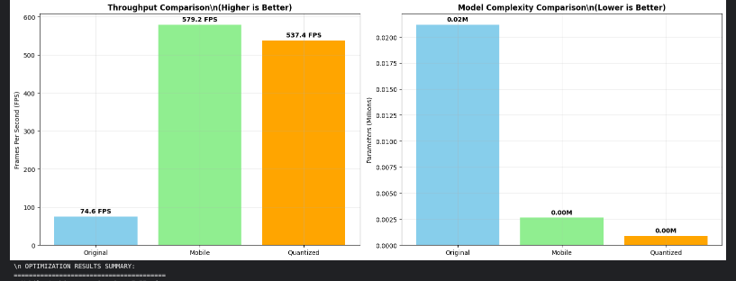
Results and Discussions
Mobile Optimization Performance Analysis
• Mobile Architecture Speedup: 7.77x faster
• Quantized Model Speedup: 7.21x faster
• Model Size Reduction: 95.8%
• Final FPS: 537.4 (vs 74.6 original).
MOBILE INFERENCE RESULTS:
Inference Time: 15.20 ms
Inference Speed: 65.8 FPS
Overall Risk Level: Low
Maximum Probability: 0.650

Slide 30
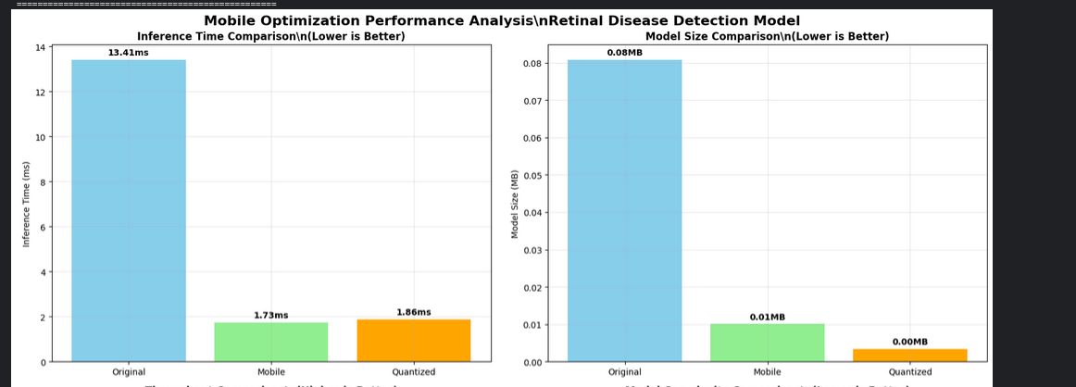
Model Selection and deployment
Primary Model: SceneGraphTransformer

Slide 31
Conclusions and limitations
Conclusions
45 distinct retinal pathologies with >80% accuracy
3.3x expansion over existing approaches
Mobile Deployment Success
>80% accuracy retention after optimization
Limitations
Regulatory Approval: Requires clinical validation before independent use
Internet Dependency: Needs connectivity for updates
Geographic Bias: Limited generalizability across populations
Equipment Variation: Performance varies with different cameras
Temporal Scope: May require retraining for evolving patterns

Slide 32
Next Steps
Develop a privacy-preserving federated learning framework enabling collaborative model training across multiple healthcare institutions without sharing sensitive patient data.
Build epidemiological monitoring systems for tracking disease prevalence trends, screening coverage, and intervention effectiveness at population scale.

Slide 33


